Slide 1
Linked List, Stack, Queue
VMIT – Day 7

Slide 2
Browser Back History
Undo Operations in Software
Visited pages stored in sequence. Reverse helps display latest visited first.
Example:
Google → YouTube → Gmail
Reversed:
Gmail → YouTube → Google
Actions performed:
Type A → Type B → Delete
Undo should happen reverse order:
Delete Undo → Type B Undo → Type A Undo
Train Route Return Journey
Call Log / Chat Messages
Stations:
Bangalore → Chennai → Hyderabad
Return route:
Hyderabad → Chennai → Bangalore
Oldest first:
Msg1 → Msg2 → Msg3
Need latest first:
Msg3 → Msg2 → Msg1
Click for code

Slide 3


Detect Cycle in Linked List
A cycle means some node points back to an earlier node instead of ending at None.
Used in:
Browser history structures
Playlist navigation
OS scheduling structures
Memory references
Network routing loops
If a cycle exists:
Traversal never ends
Infinite loops happen
Memory/process issues
App may hang

Slide 4
Slow runner
Fast runner
If track is circular, fast runner eventually catches slow runner.
If no circle, fast runner exits track.
That is Floyd’s Algorithm idea.

Slide 5
Queue using Two Stacks
Interrupt Request Handling in Embedded Systems
Why Two Stacks?
Queue using two stacks can manage software receive buffer.
Example:
Packets:
P1, P2, P3
Output:
P1 first
Microcontrollers like Microchip Technology PIC, STMicroelectronics STM32, or Texas Instruments controllers receive multiple interrupts:
Sensor trigger
UART receive
Timer overflow
Button press
These requests should be handled in arrival order.

Slide 6
Practical Embedded Example
Interrupt Request Handling in Embedded Systems
In an Arduino Uno based smart home board:
Events arrive:
Door sensor open
Motion sensor detected
Temperature high
Need FIFO handling.
Queue ensures oldest event processed first.
Queue using Two Stacks is useful in embedded and electronics systems where stack operations are easy to implement, but FIFO processing is required for interrupts, sensor events, and communication buffers.

Slide 7
Trees & Recursion Mastery
Keep your notebooks and pen ready
Take notes as we progress
Solve Assignments

Slide 8
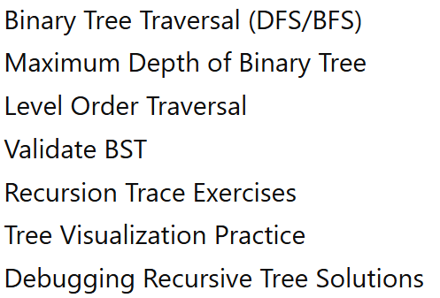
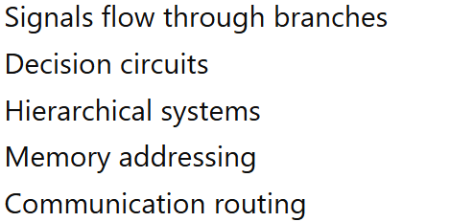
A tree is simply a branching data path.

Slide 9
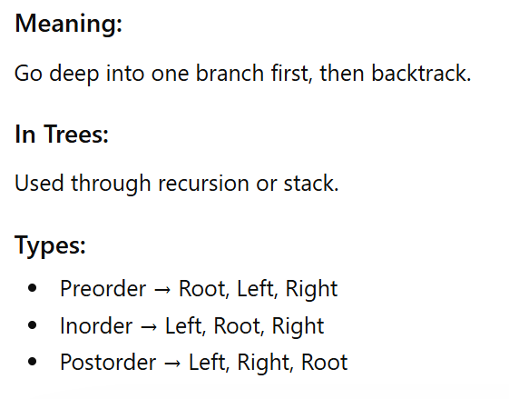
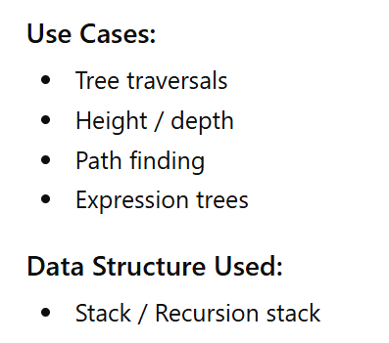
DFS (Depth First Search)

Slide 10
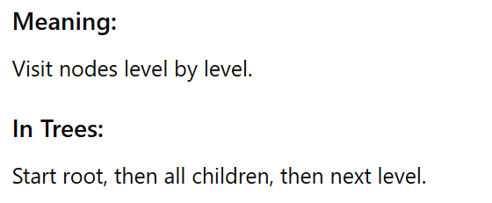
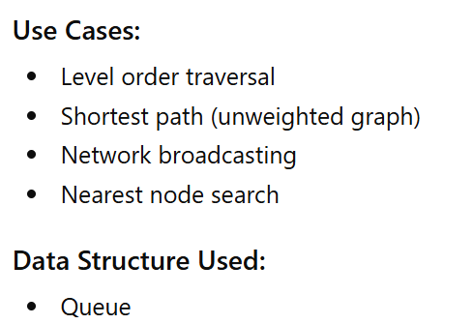
BFS (Breadth First Search)

Slide 11
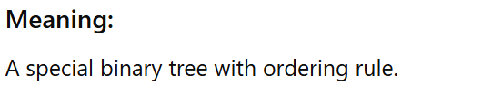
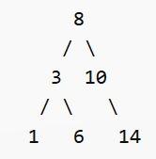
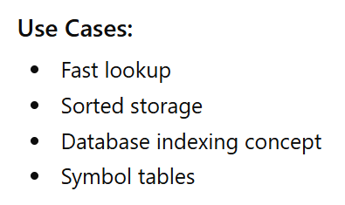
BST (Binary Search Tree)
Left subtree values < Root < Right subtree values

Slide 12
Comparison
Topic | Full Form | Structure Used | Best For
DFS | Depth First Search | Stack / Recursion | Deep traversal
BFS | Breadth First Search | Queue | Level-wise traversal
BST | Binary Search Tree | Tree with order | Fast search

Slide 13
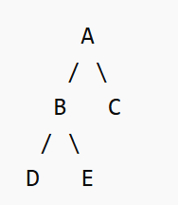
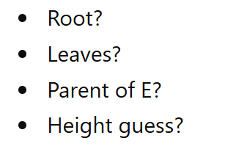
Examples in ECE:
Folder structure in embedded systems
Decision logic circuits
Packet routing paths
Expression trees in DSP
Call hierarchy in firmware

Slide 14
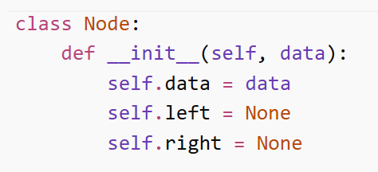

Slide 15
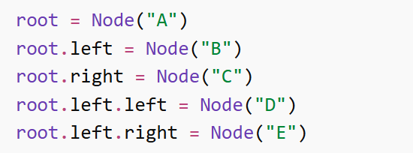

Slide 16
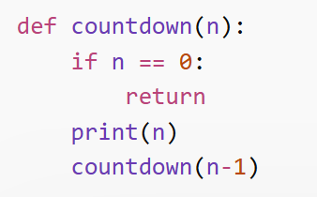
Recursion Basics

Slide 17
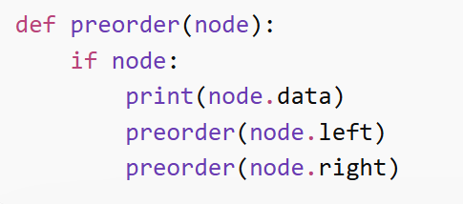
DFS Traversals (Core Skill) -Preorder
Root → Left → Right

Slide 18
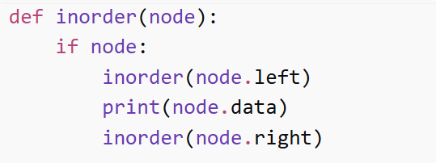
DFS Traversals (Core Skill) -Inorder
Left → Root → Right

Slide 19
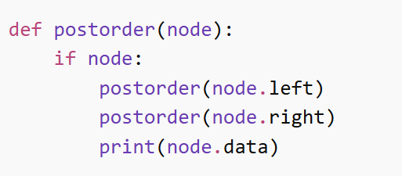
DFS Traversals (Core Skill) -Postorder
Left → Right → Root

Slide 20
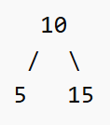
Assignment: write the solution using each order Preorder Inorder postorder

Slide 21
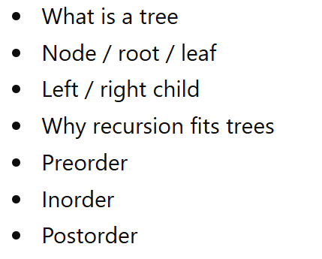
Recap

Slide 22
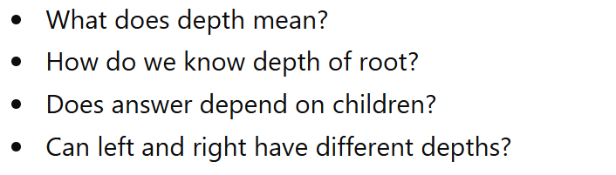
Find maximum depth of binary tree

Slide 23
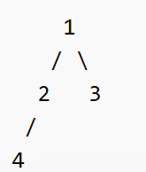
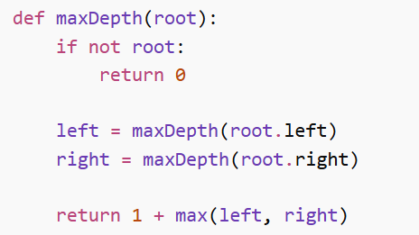
Tree
depth(root)
= 1 + max(depth(left), depth(right))
MaxDepth

